Slide 1

NEVADA HAND
More Than A Home

Slide 2

Introductions
Waldon “Wally” Swenson
Vice President of Corporate Affairs
Notes:
Welcome:
Introductions: Before we get started I would love to take a few moments to learn about you and the great work you are doing in the community.
Can you please share:
1. Your name
2. Role or a little about yourself
3. 1 Thing You Hope to take away from our discussion today
Marissa go first:
1. Marissa, Director of Resident Services -- Take Away: Is that the common investment in intersection between Health & housing (specifically housing with supports)

Slide 3

Agenda
Introduction
About Nevada HAND
Current Projects
Resident Services
What is Affordable Housing?
The State of Affordable Housing in Nevada
Affordable Housing Solutions

Slide 4
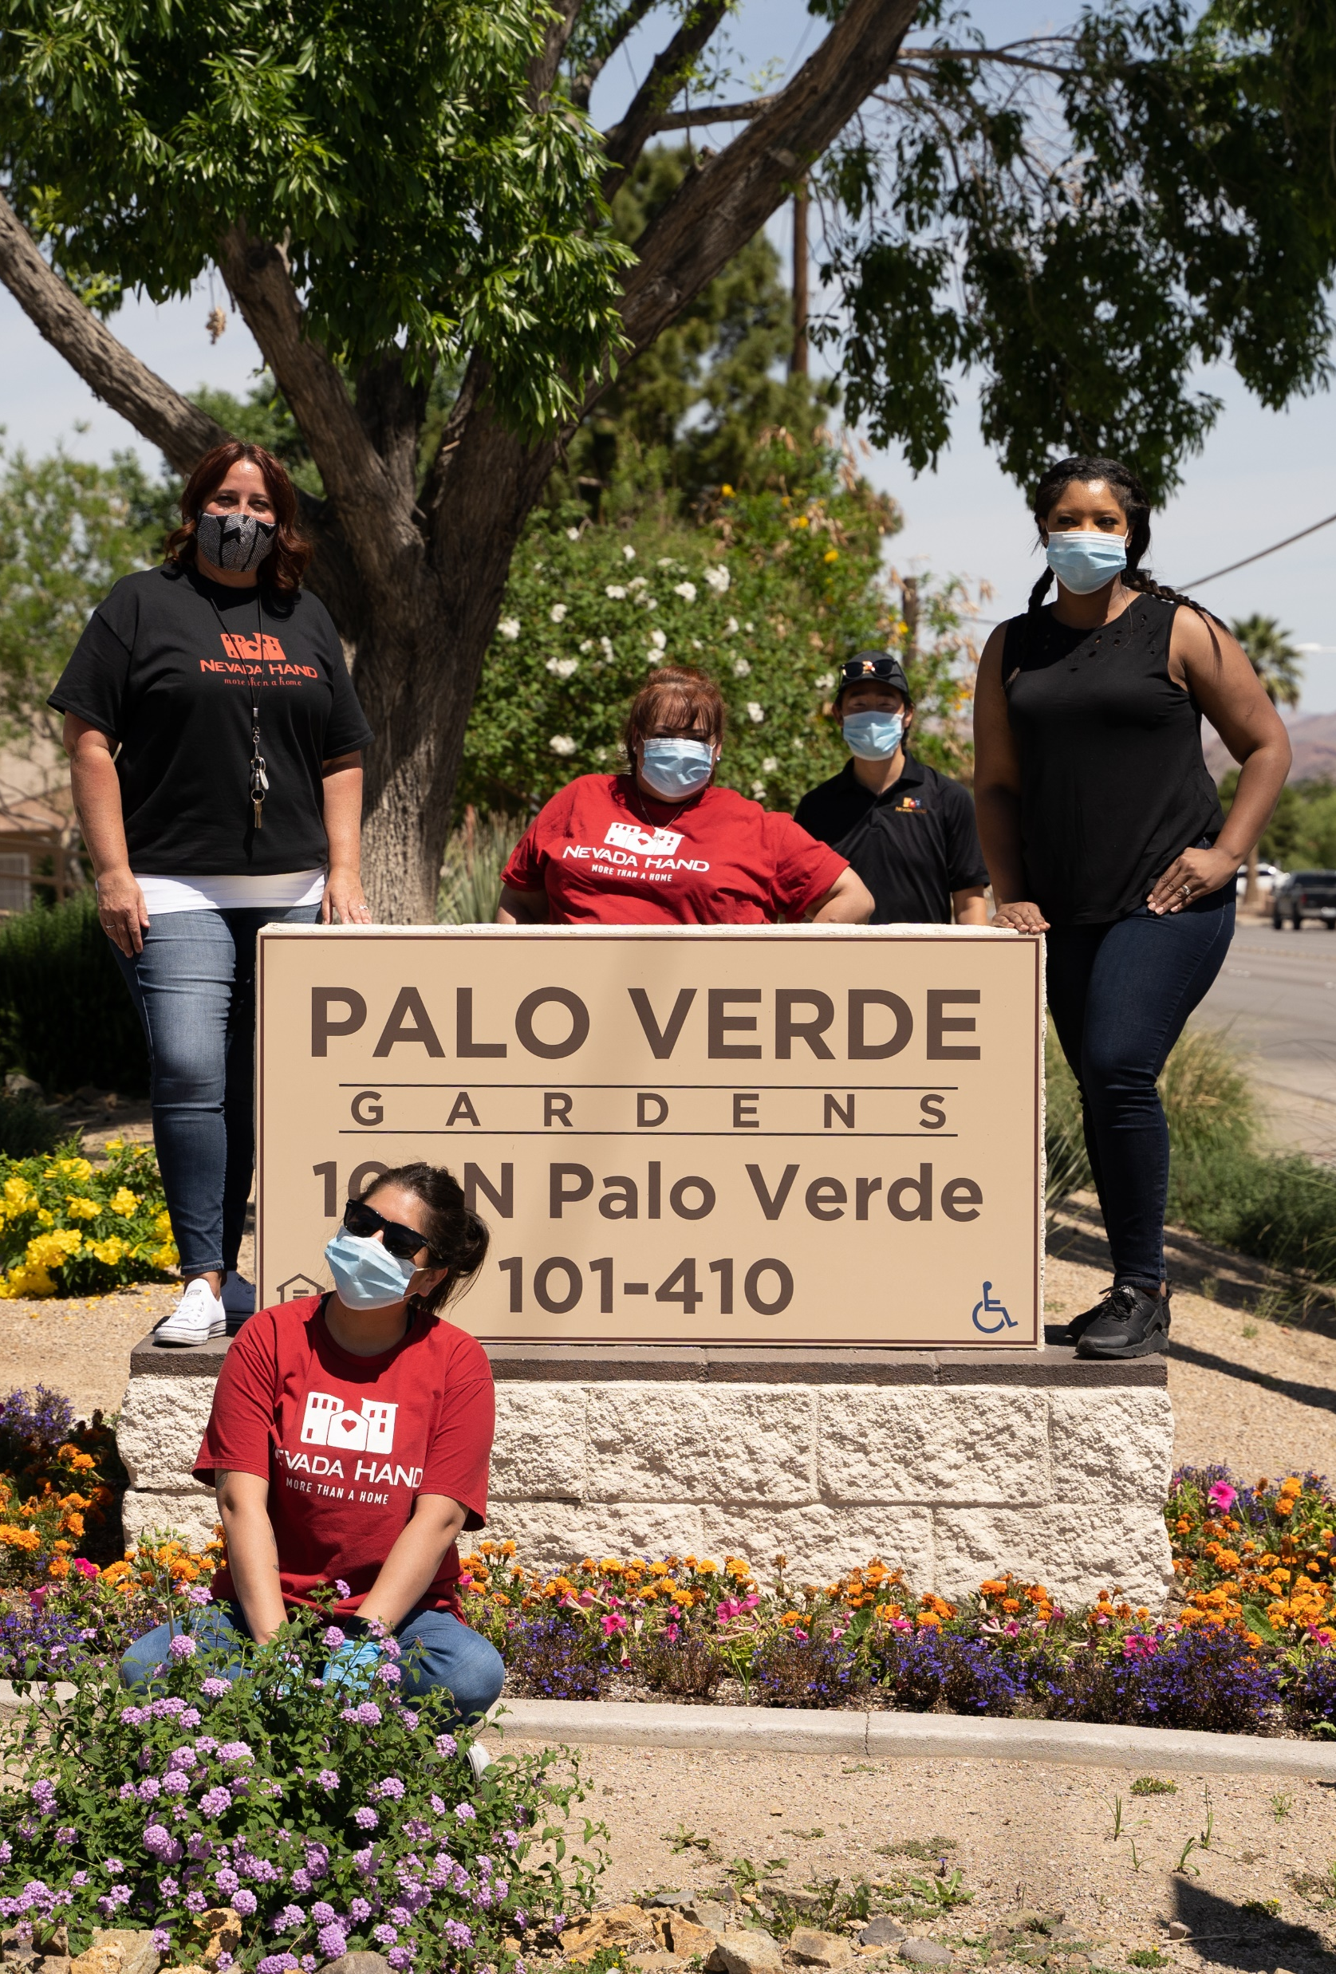
About Nevada HAND
Nevada HAND is the state’s largest affordable housing developer and a 501(c)(3) nonprofit who is dedicated to the development, construction, management, and preservation of high-quality affordable apartment communities throughout Southern Nevada.
We seek to improve the lives of low-income working families and seniors by providing positive living environments, where healthy, engaged residents can improve their economic status and take pride in their communities.

Slide 5
Company Timeline
1993
Nevada HAND is founded by Mike Mullin.
1997
HAND Construction Company (HCC) is established.
1999
Stewart Pines Apartment Homes opens.
2001
HAND Property Management (HPM) is formed. Apache Pines Apartment Homes opens.
2003
Nevada HAND establishes Resident Services team to connect our residents with supportive services.
2007
Silver Sky Assisted Living opens.
2014
Nevada HAND’s Westcliff Pines II development receives LEED Platinum certification.

Slide 6
Company Timeline
2018
Boulder Pines Community Campus opens as a collaborative hub.
2019
Nevada HAND receives its first $1 million donation from an anonymous donor.
2019
Rose Gardens is awarded the Novogradac Journal of Tax Credit Excellence for Public Housing.
2019
Nevada HAND receives its first
$2 million donation from an
anonymous donor.
2020
HAND Construction Company completes all phases of Rome Pines Apartment Homes and Flamingo Pines Apartment Homes.
Nevada HAND begins construction on Decatur Commons, our largest (480-unit) multi-family apartment community to date
2021

Slide 7
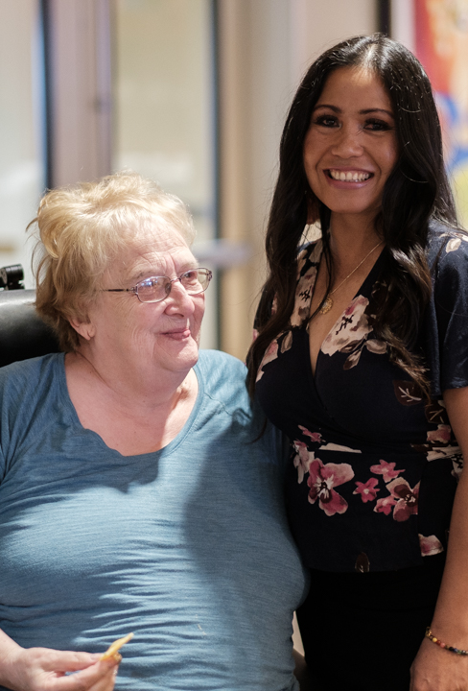
Mission and Vision
Mission Statement
Nevada HAND improves the lives of low-income individuals by providing affordable housing solutions and supportive services.
Vision Statement
Nevada HAND is committed to providing positive living environments where healthy, engaged residents can improve their economic status and take pride in their communities. We believe that providing opportunities and support for economic stability, wellness, education, and community engagement will help our residents reach their full potential, stabilize families, and transform lives.

Slide 8
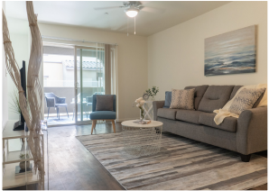
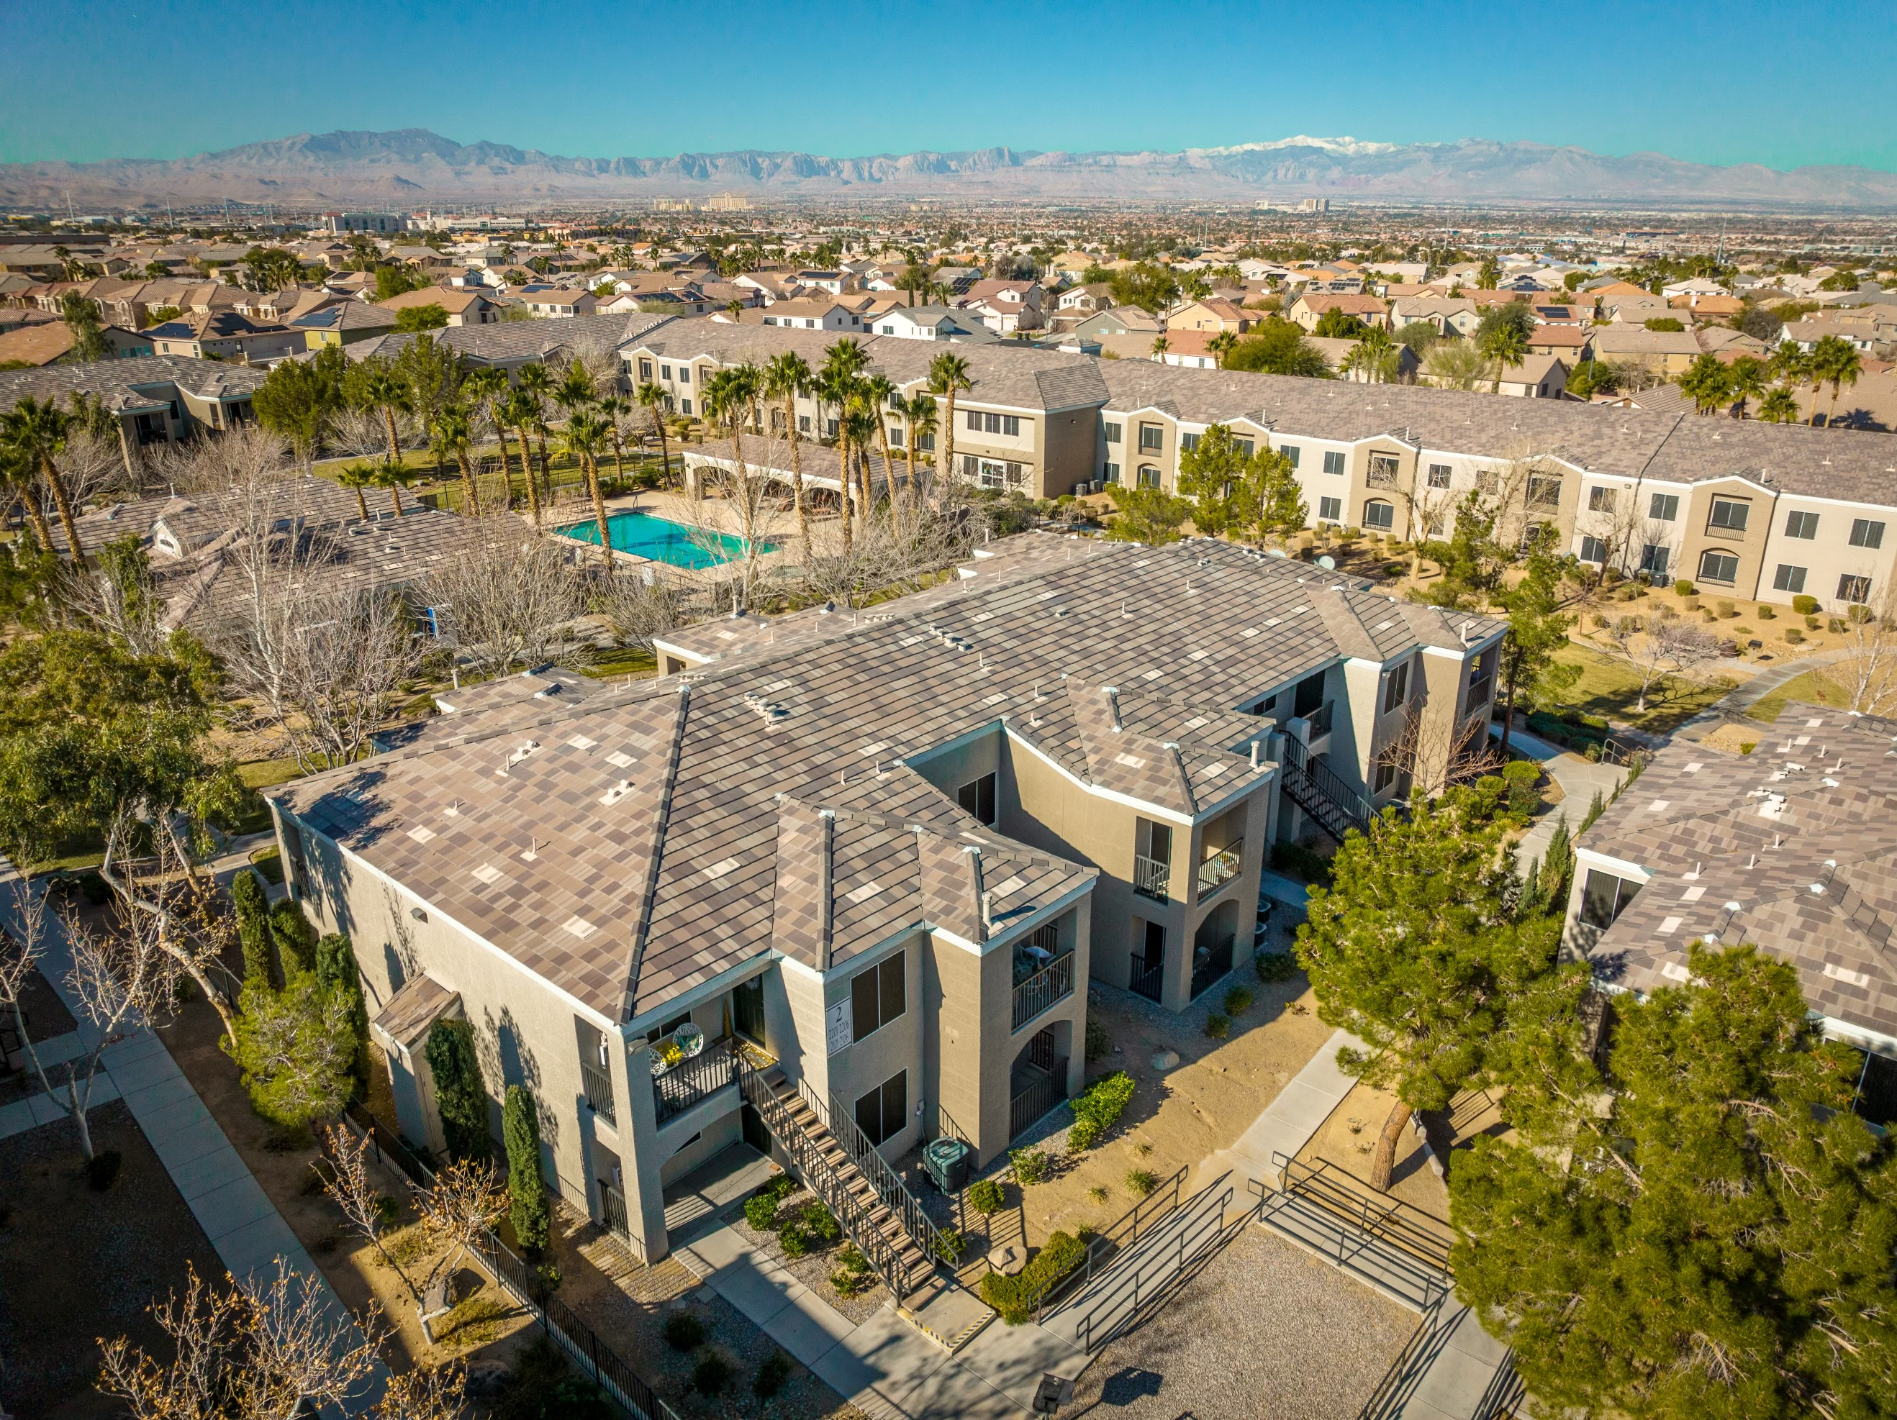
Property Portfolio
Nevada HAND serves over 8,000 people every day, including working adults, children, and seniors.
Currently, Nevada HAND’s portfolio consists of:
35 affordable apartment communities
  11 family communities
  22 independent senior communities
  2 assisted living communities
5,000+ high-quality affordable apartment units

Slide 9
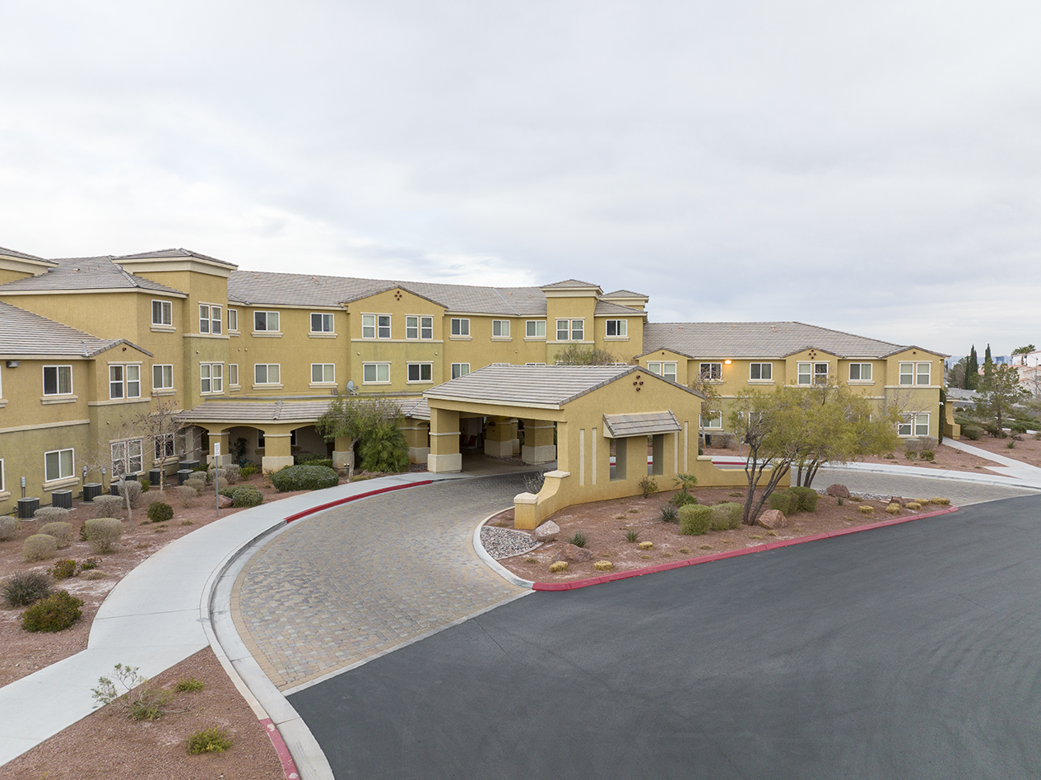
HAND Senior Living
Assisted living is one of the fastest-growing long-term care options for aging seniors, and Nevada HAND is the only organization in Nevada to offer affordable assisted living communities. Silver Sky Assisted Living and Silver Sky at Deer Springs are Nevada HAND’s two all-inclusive assisted living communities that provide 180 units of affordable housing for seniors (55+).
Nevada HAND’s Assisted Living communities are designed for seniors who may not be able to live on their own safely, but do not require the higher level of care provided in a nursing home. Our Assisted Living communities, Silver Sky and Silver Sky at Deer Springs, offer the following:
  Activities of daily living (bathing, dressing, personal hygiene, escorting, etc.)
  Medication management
  Meal service
  Transportation
  Housekeeping
  Laundry Services
  Life enrichment/community life activities
  Coordination of care

Slide 10
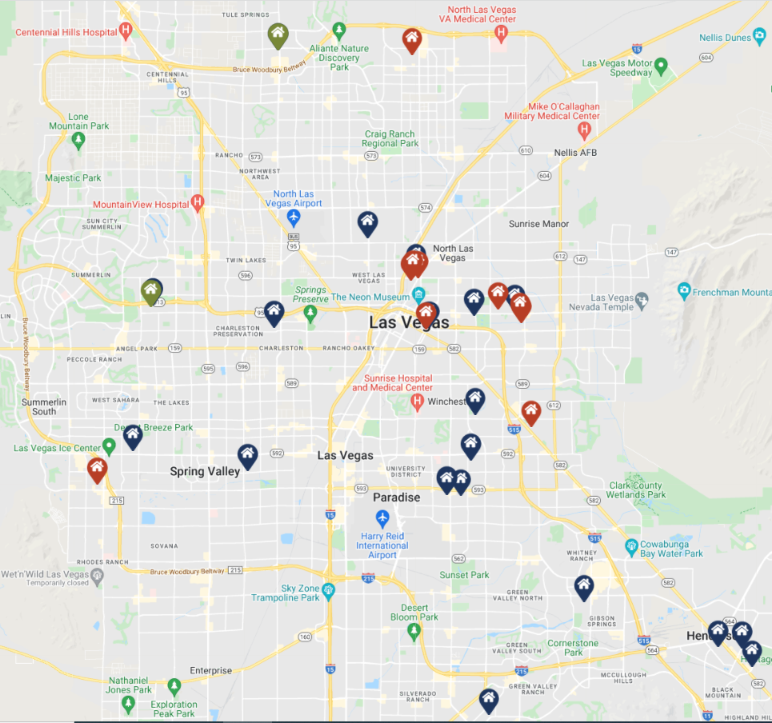
Nevada HAND’s Property Portfolio (cont.)

Slide 11
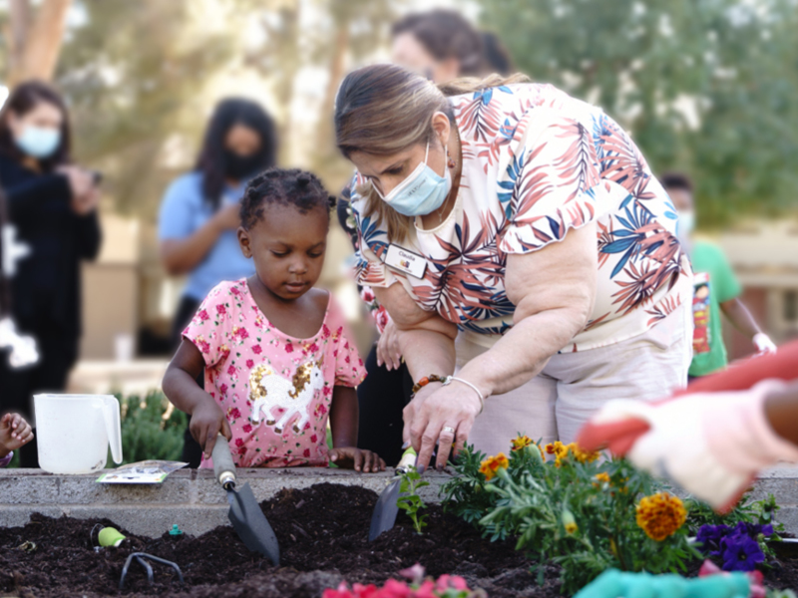



Our Approach
Nevada HAND builds its high-quality homes to inspire pride of place and instill a sense of neighborhood for our residents, as well as creating an amenity for the entire community.
Nevada HAND’s communities offer a unique combination of high-quality, affordable homes with amenities like pools, community rooms, playgrounds and walking paths, and opportunities for residents to get know their neighbors. Our homes bring value to neighborhoods are built with the intent of being a long-term community asset.
Our construction team works with our development team, investment partners, property management, and resident services to ensure our properties are appealing, functional, and built with our residents’ needs in mind.
Embracing Accessibility

Slide 12


Slide 13
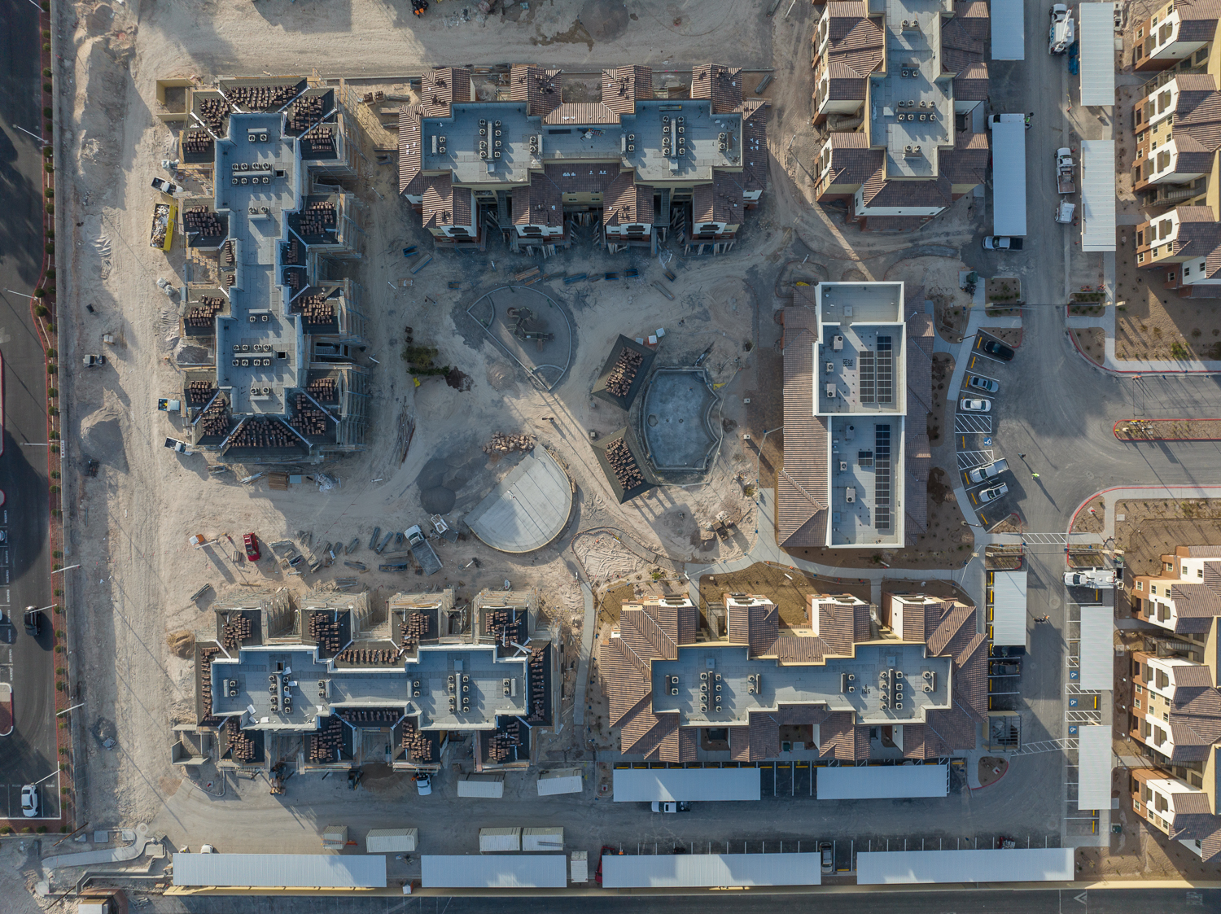
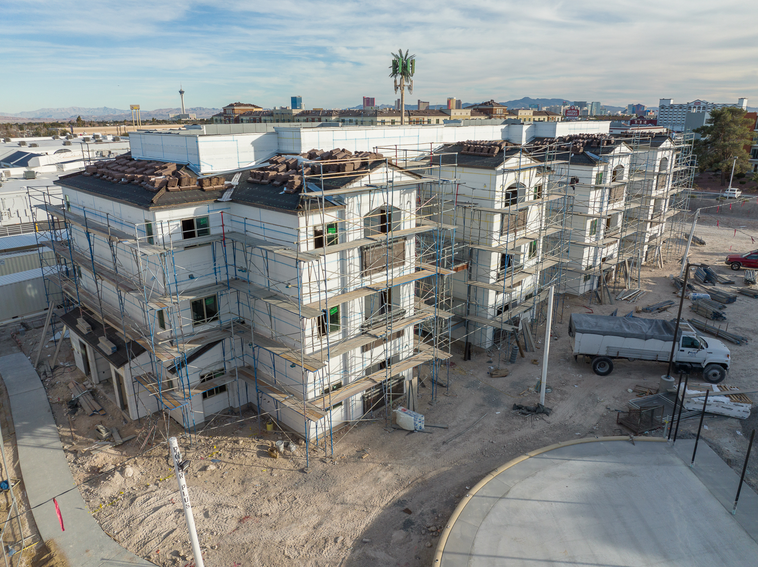
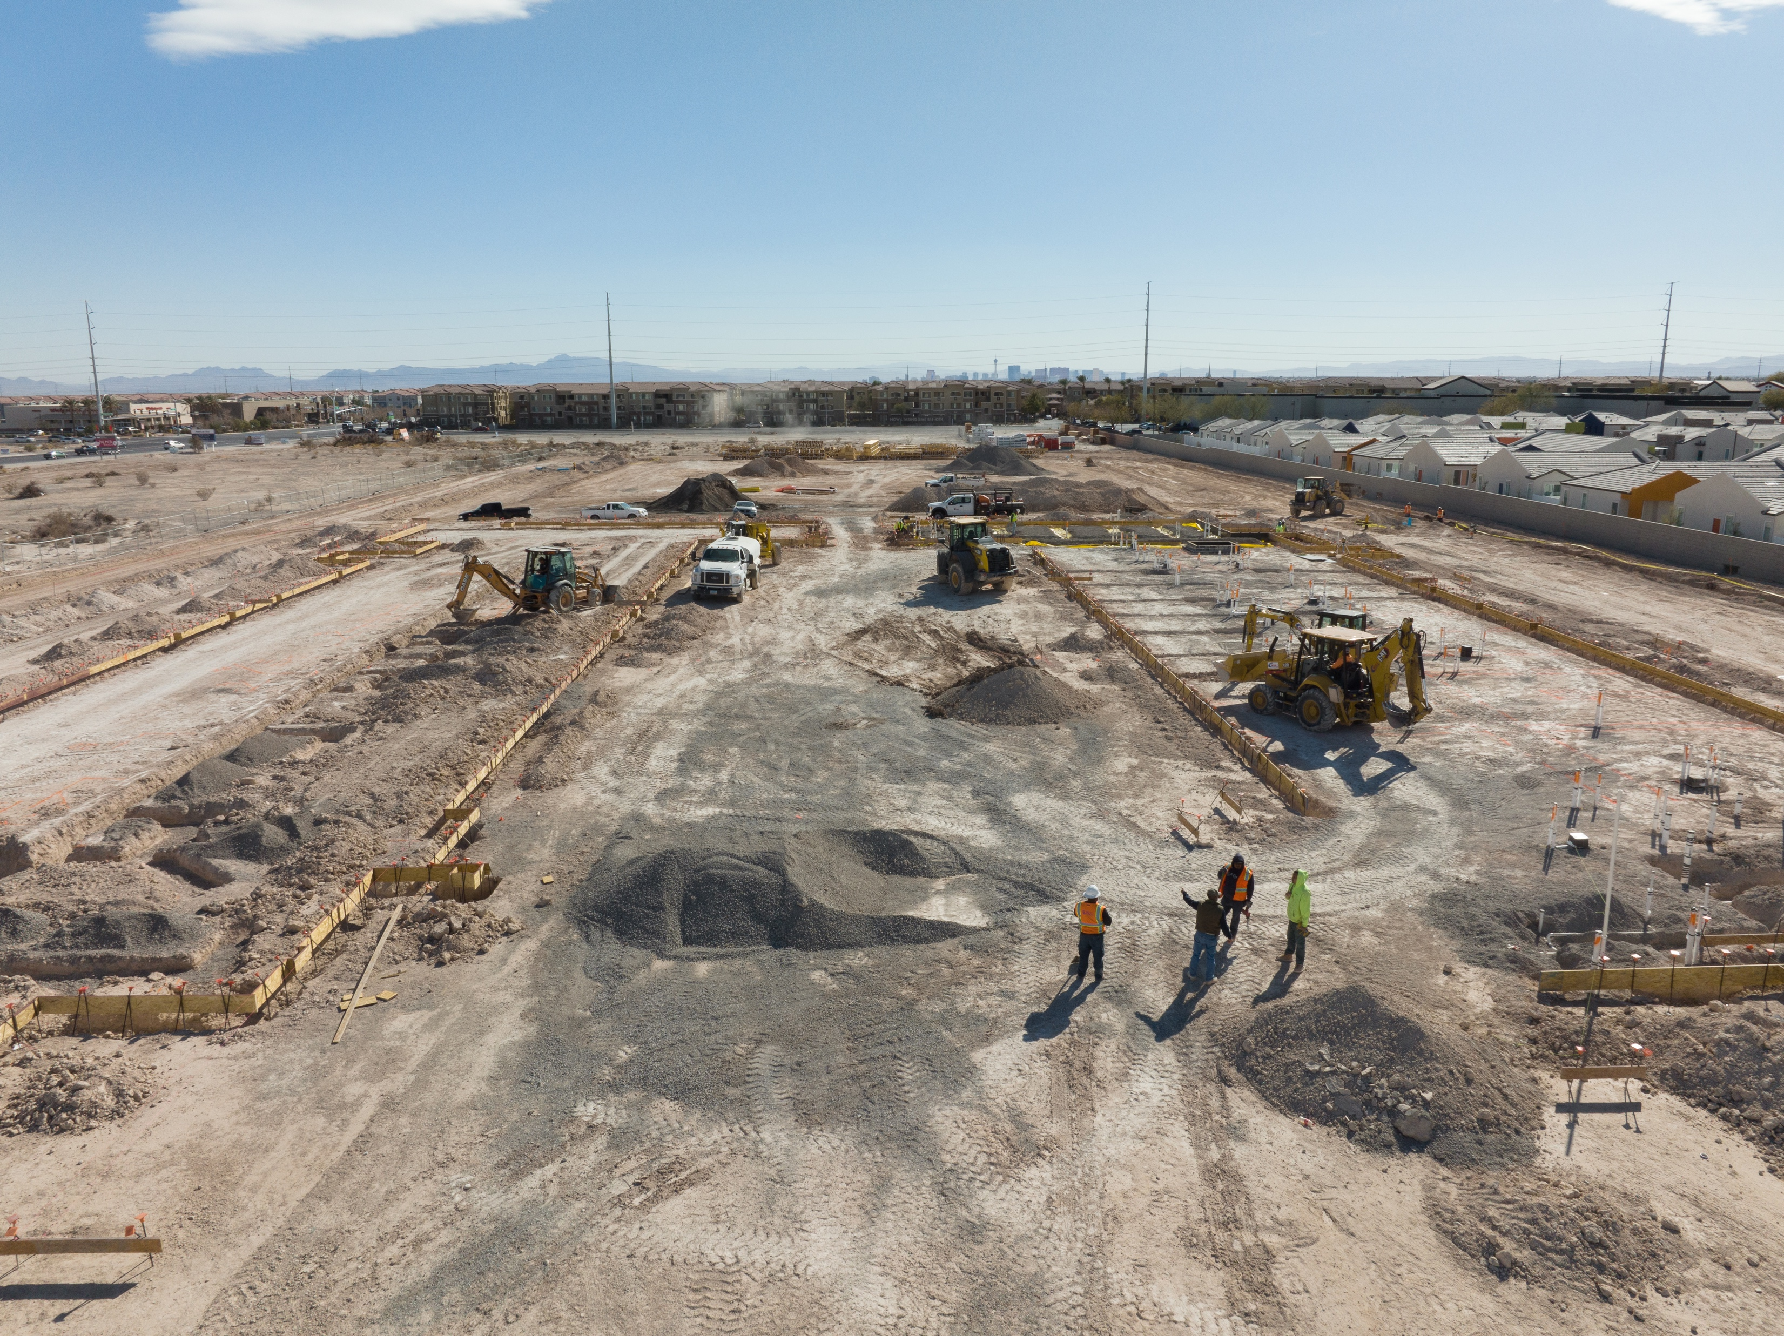
Nevada HAND’s Current Projects
Recently Completed:
Decatur Commons Family – New Construction (late 2022)
  240 affordable units
Decatur Commons Senior – New Construction (late 2022)
  240 affordable units
Desert Pines – Rehab (January 2023)
  204 affordable units
Under Construction:
Rome Pines Senior – New Construction
  220 affordable units
Rochelle Pines – Rehab
  115 affordable units
In the Pipeline:
Buffalo/Cactus – New Construction
  125 affordable units
Decatur/Pyle – New Construction
  450 affordable units

Slide 14
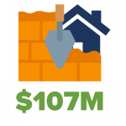


Annual Economic Impact
construction activity (local income, taxes, and local government revenue)
local jobs supported by construction activity
average rent savings from market-rate apartments, which was funneled back into the local economy
Notes:
We are established and trusted by national organizations and peers, and our economic impact includes about $107 million in current construction into the Southern Nevada community. We build high quality homes that are affordable to working families and seniors on fixed incomes to help them free up their income for other critical necessities – like nutritious food, healthcare, education, and more.

Slide 15
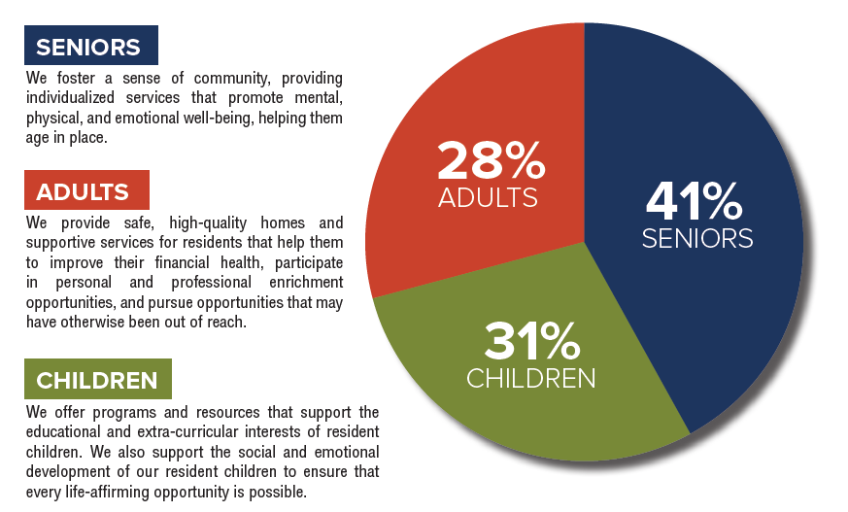

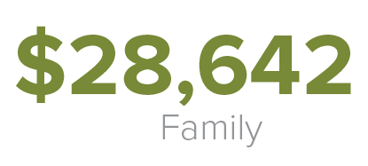
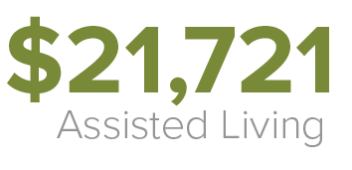
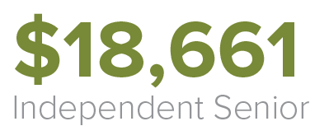
Nevada HAND Residents
Notes:
Compassionate rent collection measures: including calls and check-ins, dropping off rent payment kiosk envelopes, and reminding our residents of new payment plan programs that are available to them. Additionally, we have new procedures in place for resident referrals to the resident services team to help them quickly connect to rental assistance, utility assistance, and other aid programs.

Slide 16
Nevada HAND’s affordable apartment communities are coupled with life-changing and community-enriching Resident Services.

Slide 17
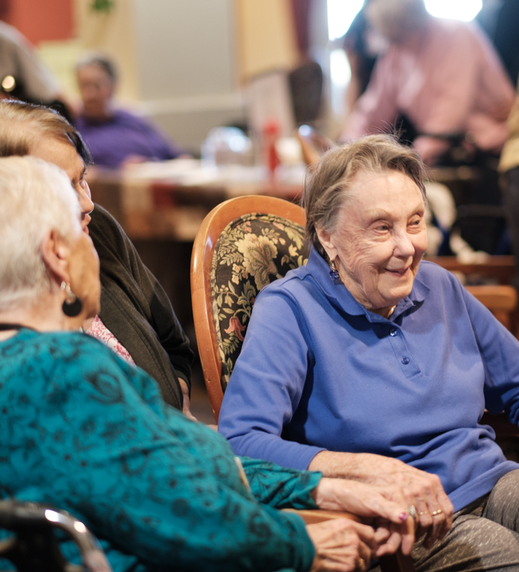


Resident Services
Nevada HAND’s Resident Services team provide supportive services, programs, and resources to ensure our residents have the tools and opportunities to live well.
Resident Services works to deliver four key pillars that propel social and economic stability:
  Education
  Health & Wellness
  Economic Stability
  Engagement

Slide 18
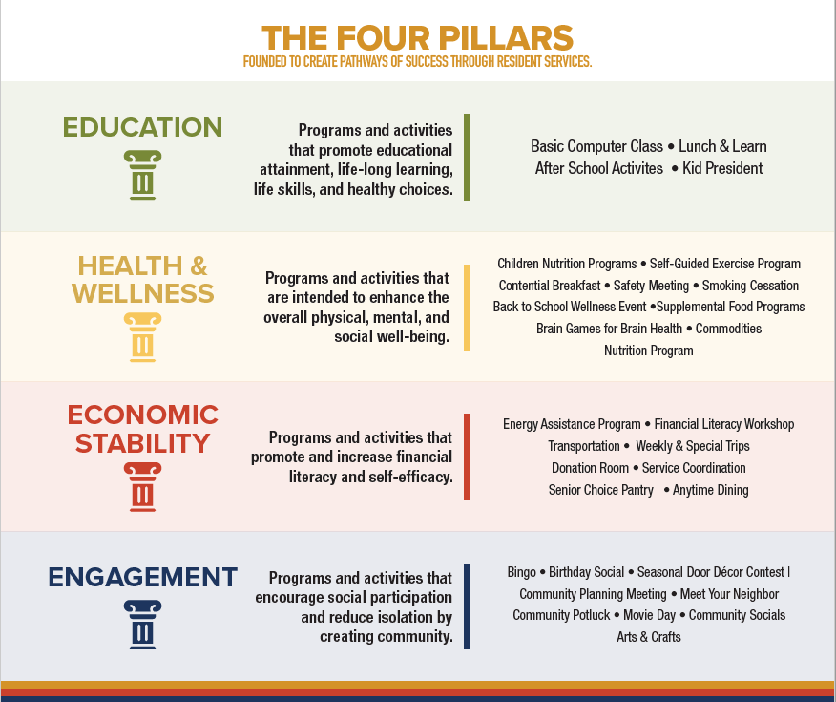

Slide 19








Community Partners

Slide 20
Access to quality affordable housing is a key element of a strong and secure Nevada.

Slide 21
What is Affordable Housing?
According to the federal government, housing is affordable when rent or mortgage payments (principal, interest, taxes, insurance) plus utilities are no more than 30% of the occupant's monthly income. Regardless of income, policymakers consider households contributing more than 30% of their income towards housing as cost-burdened.
In Nevada, renters making up to 120% of the area median income (AMI) are eligible for affordable housing.

Slide 22

Affordable Housing in Nevada
According to the National Low-Income Housing Coalition, Nevada has a shortfall of over 84,000 units of affordable housing.
Renters make up over 45% of Nevada, and they bear the brunt of the shortfall in affordable homes.
The average monthly rent for a one-bedroom apartment is now around $1,500. The average rent for Nevada HAND’s residents is $733 a month.

Slide 23
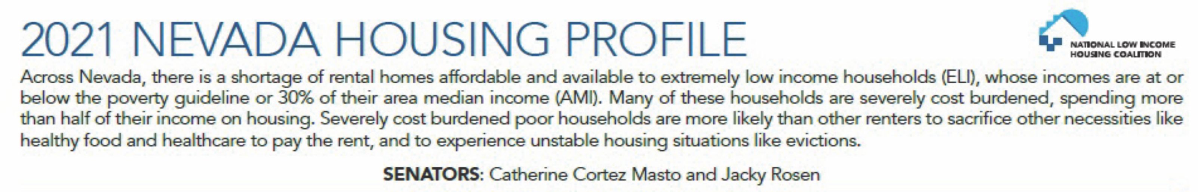
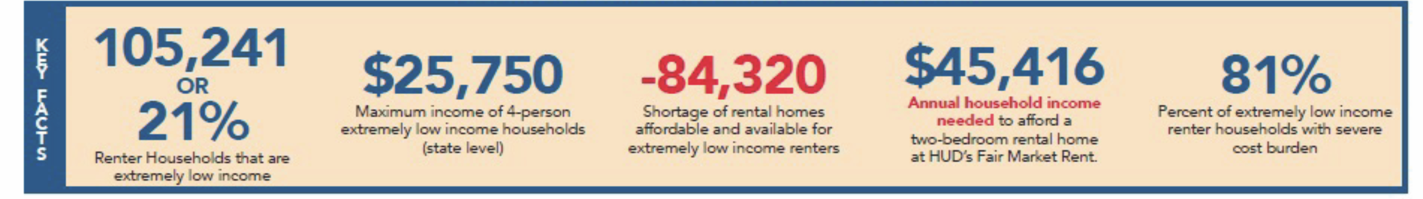
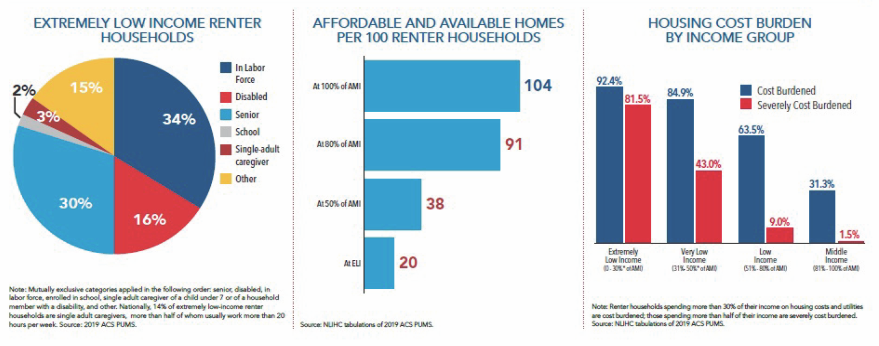
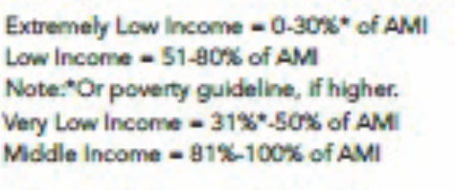

Slide 24
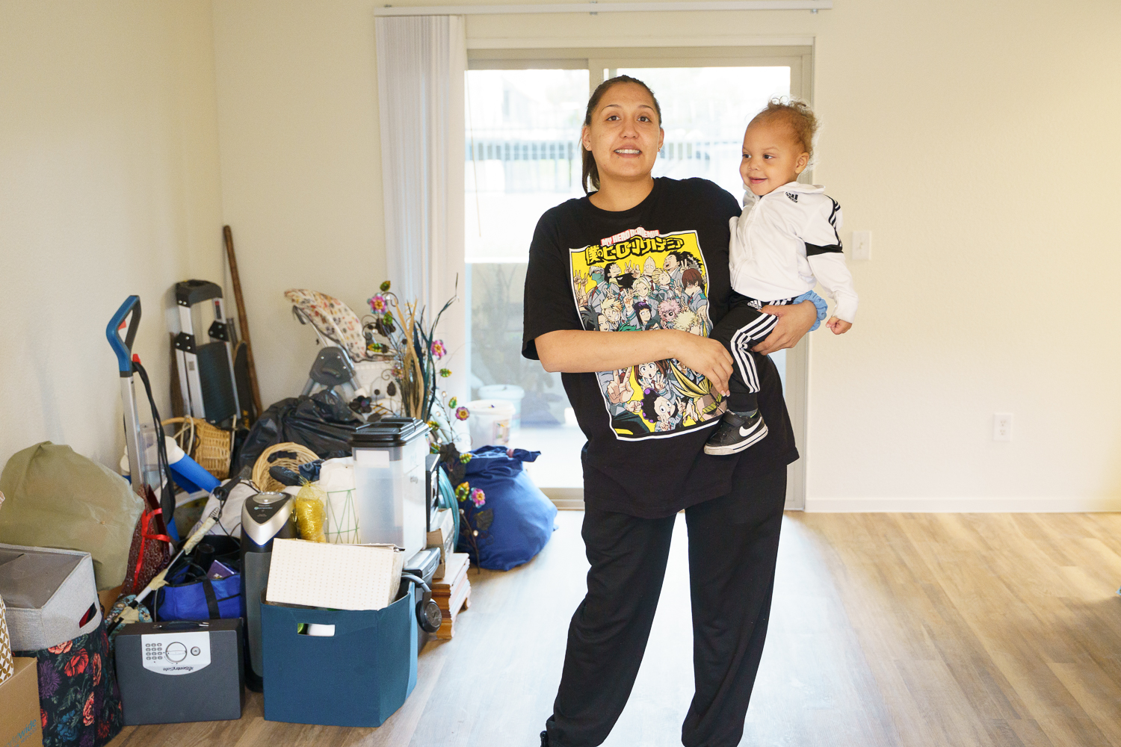
Affordable Housing Solutions
Housing Choice Vouchers
Project-Based Section 8 Vouchers
Expand the Low-Income Housing Tax Credit Program
Land Availability
Philanthropy Dollars to support Nevada HAND in its mission

Slide 25
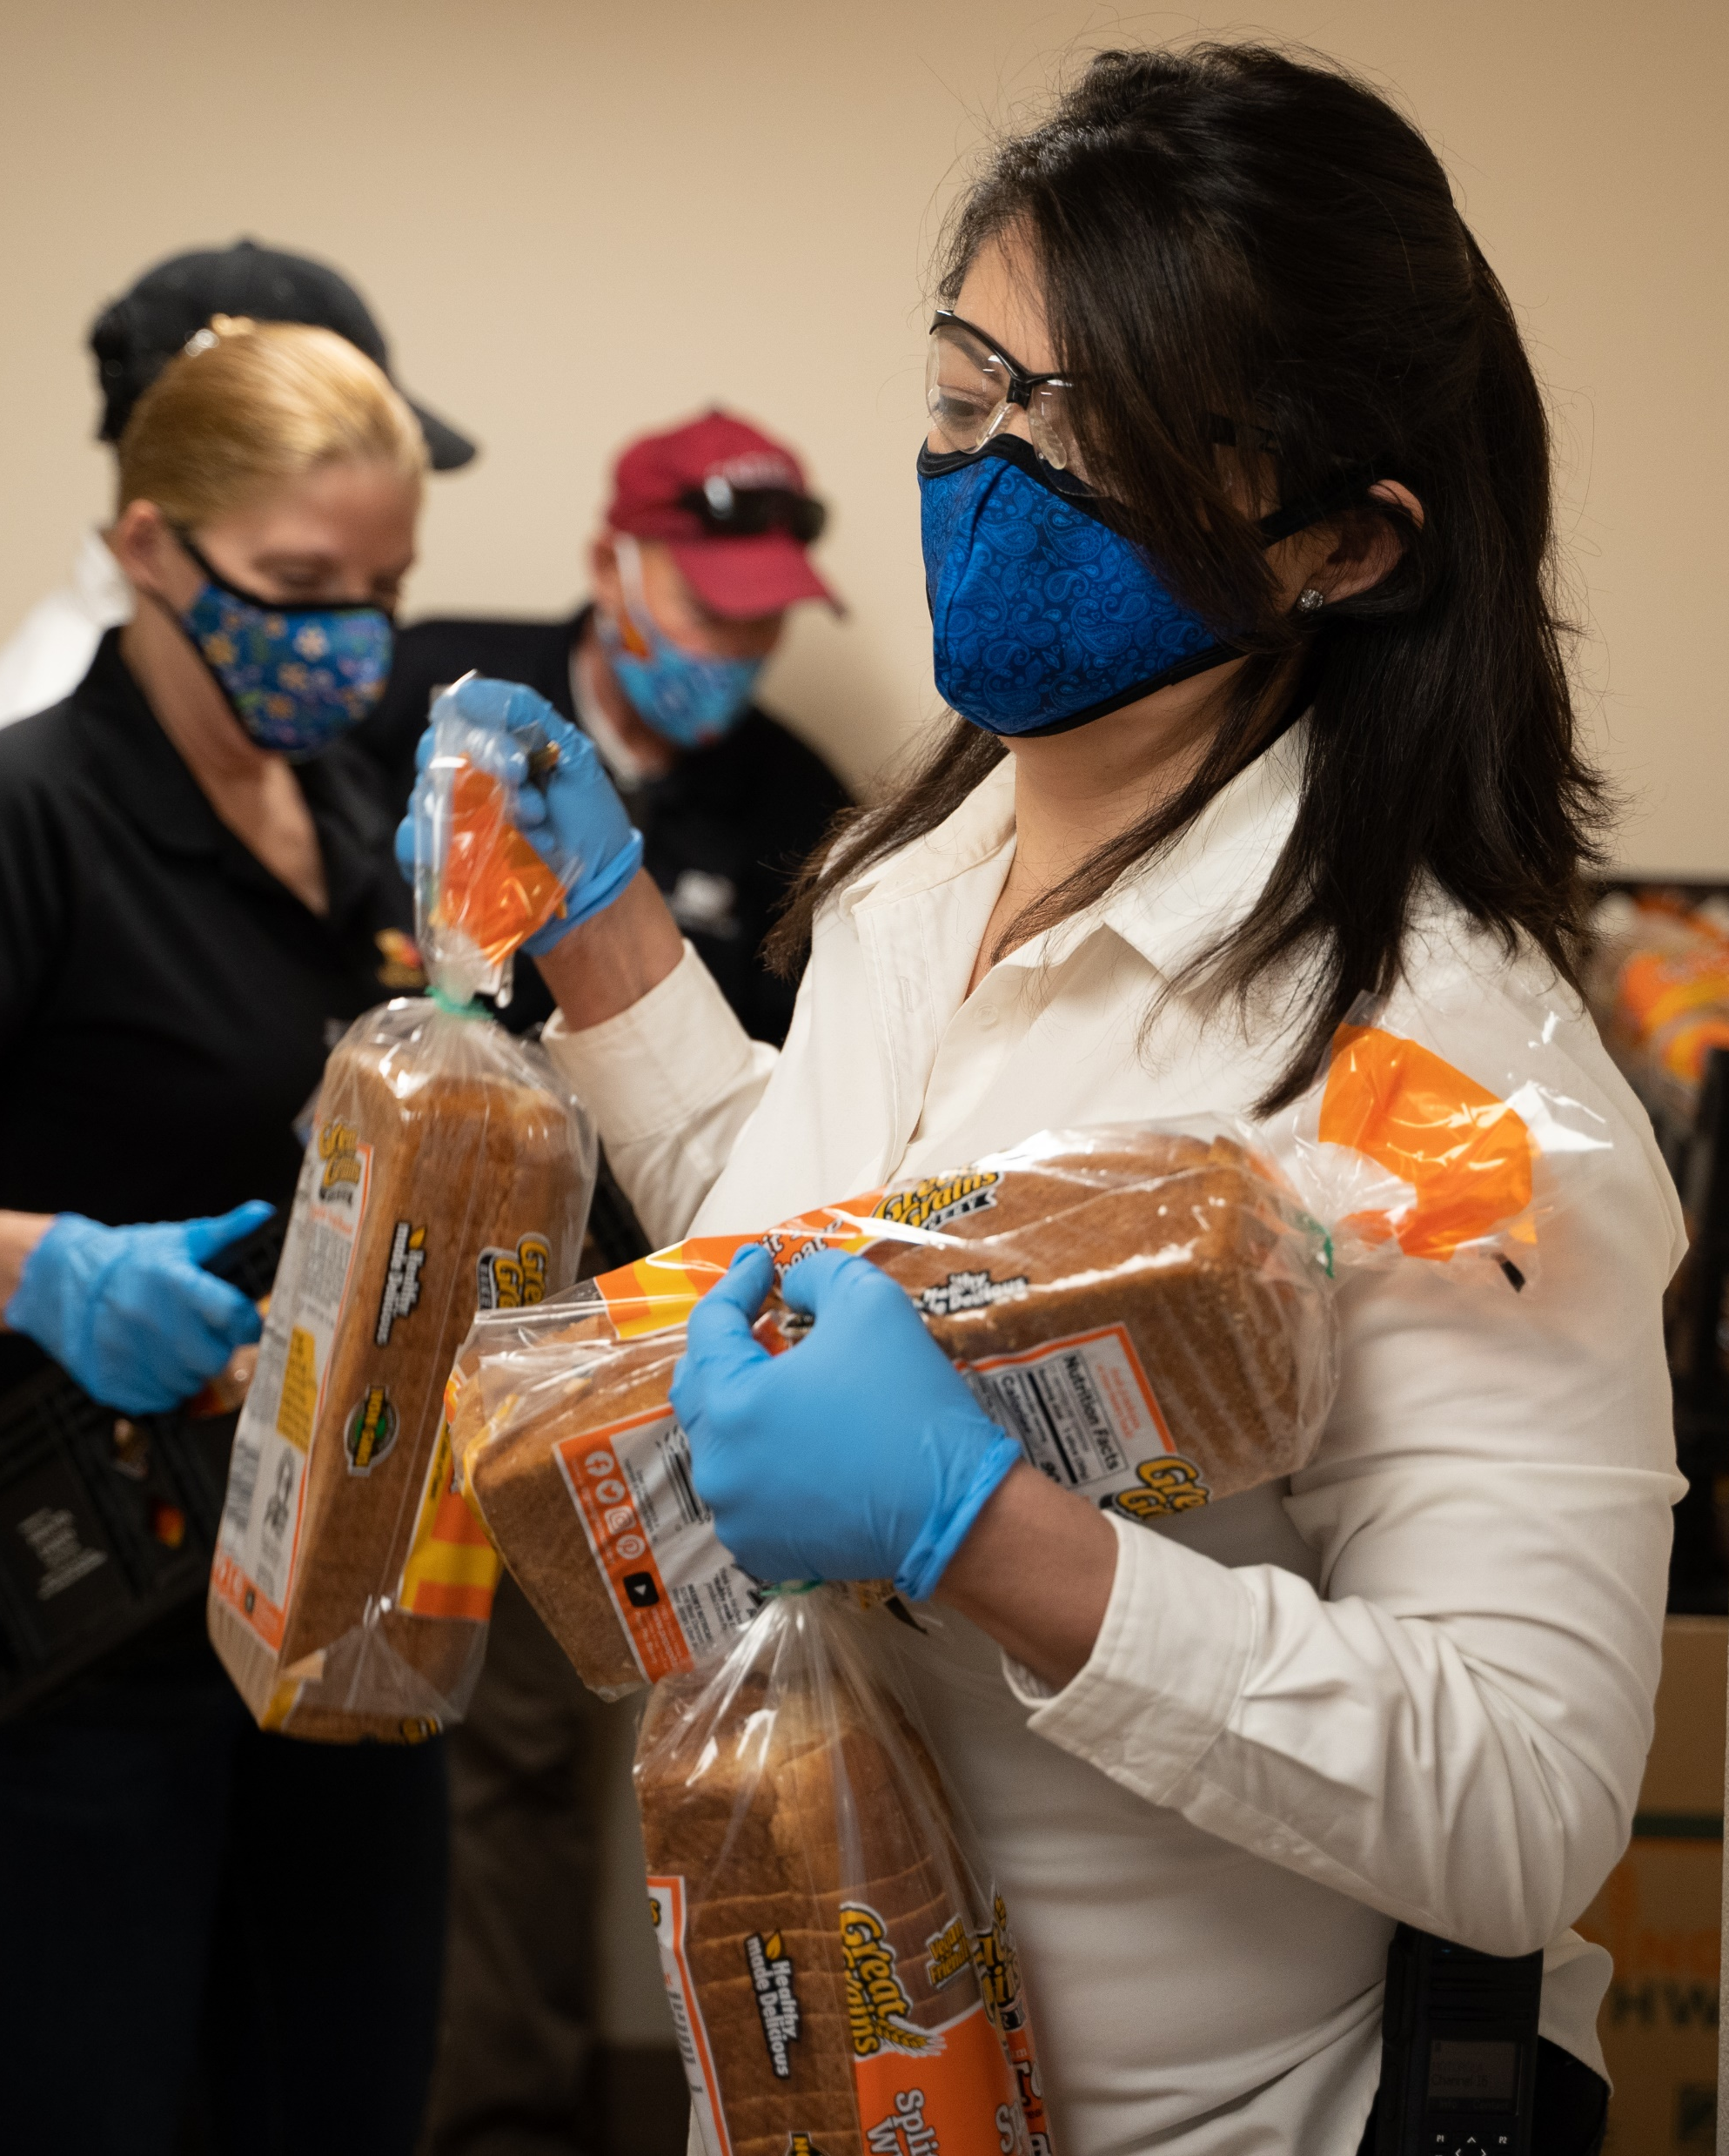





How to Support Us
Subscribe to our monthly newsletter, The Neighborhood
Make a financial donation
Engage with us on social media @NevadaHANDLV
This Photo by Unknown Author is licensed under CC BY-SA

Slide 26
THANK YOU
Notes:
Questions / Comments?

